Slide 1
Navigating Gold's Future: A Data-Driven Forecast
Possible Future Paths for Gold Prices
Presented by: Adewale Abolade

Slide 2
Unveiling Gold Price’s Historical Journey
Gold prices rarely follow a smooth, linear path. Historically, they exhibit distinct long-term trends punctuated by sudden, significant surges and drops.
This inherent volatility makes simplistic, point-in-time predictions highly challenging and often inaccurate, thereby confirming non-stationarity and supporting the use of trend-adjusted or differenced time series models for forecasting.

Slide 3
Decomposing the Gold Price Series
Separating Structure from Noise
Revealing Core Dynamics
By breaking down the complex gold price series, we can isolate fundamental underlying structures from ephemeral, random fluctuations.
This decomposition allows us to understand the persistent forces driving gold prices, distinct from short-term market noise or transient events.
Enhanced Clarity
The decomposition reveals that gold prices are dominated by a strong upward trend with minimal seasonal influence, while residual fluctuations appear random, supporting the use of non-seasonal or lightly seasonal ARIMA models for forecasting.

Slide 4
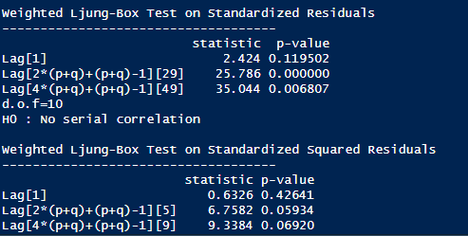
Residual Analysis: Understanding Volatility
After making the data stationary and fitting the model, the diagnostic plots and test confirm that the model is a valid fit for gold price data based on the following indicators:
Randomness: The standardized residuals show a random scatter around zero with stable variance, indicating the model has captured the data's underlying structure.
Independence: Both the ACF plot and Ljung-Box test (p-values > 0.05) confirm the residuals behave as "white noise," meaning no significant information or patterns remain uncaptured.
Normality: The Q-Q plot indicates that forecast errors are generally normally distributed, despite minor tail deviations typical of volatile market shocks.

Slide 6
Gold Price Prediction
The forecast plot reveals a projected trajectory for gold prices based on historical trends. This plot projects a sustained bullish trend for gold prices, centered on a $4,500/oz base case by year-end (range: $4,000 to $5,055/oz) and bearish of $4,000/oz.
The shaded regions surrounding the forecast (typically 80% and 95% intervals) illustrate the degree of uncertainty in the predictions, with the widening bands reflecting the increasing risk and potential volatility of gold prices over time.
Key notes:
Bullish : If things go really well for gold, it could reach $4,700–$5,000.
Bearish : If prices drop, it’s expected to stay around $4,000.

Slide 7
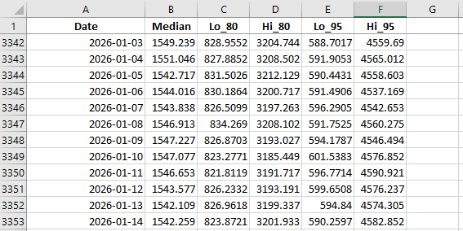
Screenshot on predicted ranges

Slide 8

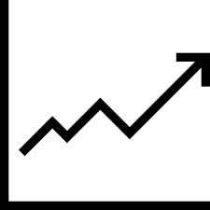


Key Takeaways
Understanding Uncertainty
Risk Management
True financial forecasting is about comprehending the range and nature of future uncertainty, not chasing a single, illusory exact number.
A robust understanding of potential outcomes enables more effective risk assessment and strategic portfolio adjustments.
Adaptive Strategies
Informed Decisions
Forecasting models should support flexible strategies that can adapt to varying market conditions and unexpected shifts.
Equipped with a probabilistic view, investors can make more resilient and data-driven investment choices.

Slide 9


